Slide 1
An Introduction to Graphics
Casey McCullough
Intro to Programming
November 7, 2026
Notes:
Features:
Einstein.mcp

Slide 2
Let’s begin with graphics
Download / Open SampleGraphics.java
Save to your CS folder
Compile and Run
Save as YourLastNameGraphics.java

Slide 3
Working with Graphics
1. Make necessary imports
import java.awt.*;
import javax.swing.*;
2. Your class must extend Jframe
public class SampleGraphics extends JFrame
{
public static void main(String args[])
{ // rest of main() . . ..

Slide 4
Your main method--
// C - Create and display the window.
// Use YOUR class name, not SampleGraphics!
public static void main(String args[])
{
LastNameGraphics gp = new LastNameGraphics();
gp.setDefaultCloseOperation(JFrame.EXIT_ON_CLOSE);
gp.setTitle("Sample Graphics"); // Optional title
gp.setSize(1000, 800); // Set the width and height of the window
gp.setVisible(true); // Display the window
}

Slide 5
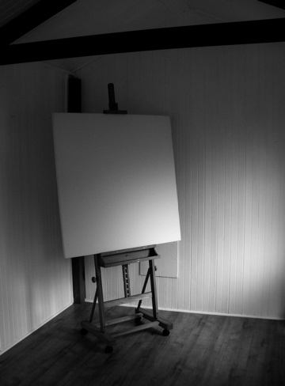
Graphics and the paint method.
public void paint (Graphics page)
The paint method accepts a parameter that is an object of the Graphics class
The paint method is executed automatically
The Graphics class has several methods for drawing shapes
A Graphics object defines
a graphics context on which
we can draw shapes and text
Notes:
A Graphics object defines
a graphics context on which
we can draw shapes and text

Slide 6
The paint method—where we draw!
public void paint (Graphics page) {
final int MID = 150;
final int TOP = 50;
setBackground (Color.cyan); // colors in entire JFrame
page.setColor (Color.blue); // changes color of your “marker”
page.fillRect (0, 175, 300, 50); // ground
page.setColor (Color.yellow);
page.fillOval (-40, -40, 80, 80); // sun
}

Slide 7

Drawing Shapes
Let's explore some of the methods of the Graphics class that draw shapes in more detail
A shape can be filled or unfilled, depending on which method is invoked
The method parameters specify coordinates and sizes
Filled shapes
Unfilled shapes

Slide 8
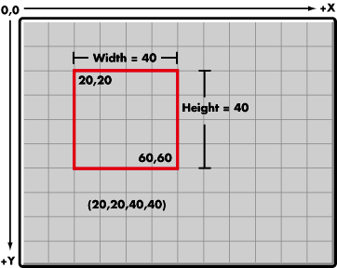
Remember, the Java coordinate system has the origin in the top left corner

Slide 9
Drawing a Rectangle
50
X
20
40
100
Y
page.drawRect (50, 20, 100, 40);

Slide 10
Drawing a Filled Rectangle
50
X
20
40
100
Y
Page.fillRect (50, 20, 100, 40);

Slide 11
Drawing a Line
10
150
X
20
45
Y
page.drawLine (10, 20, 150, 45);
or
page.drawLine (150, 45, 10, 20);

Slide 12
Drawing an Oval
175
X
20
80
bounding
rectangle
Y
50
page.drawOval (175, 20, 50, 80);
// or fillOval()

Slide 13
The Color Class
A color is defined in a Java program using an object created from the Color class
The Color class also contains several static predefined colors, including:
Object
Color.black
Color.blue
Color.cyan
Color.orange
Color.white
Color.yellow
RGB Value
0, 0, 0
0, 0, 255
0, 255, 255
255, 200, 0
255, 255, 255
255, 255, 0

Slide 14
Creating Custom Colors
Color skyColor = new Color (20, 20, 200);
// now can treat like any predefined Color.
page.setColor (skyColor);

Slide 15
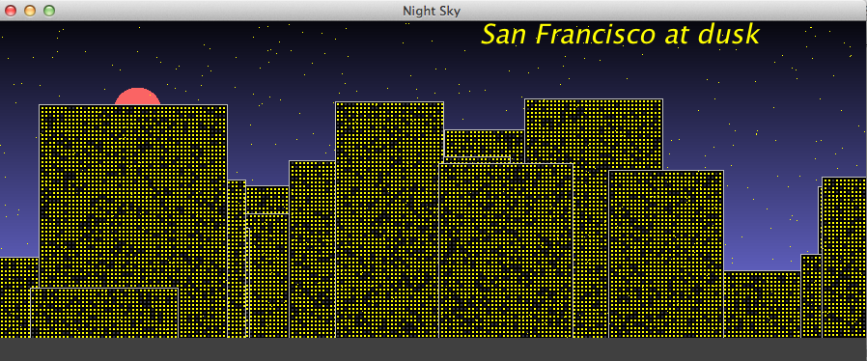
Demo NightSky.java

Slide 16
drawString()
// Name the city
g.setColor(Color.yellow);
g.setFont(new Font("Garamond", Font.ITALIC, 28));
// optional
g.drawString("San Francisco at dusk", 500, 45);

Slide 17
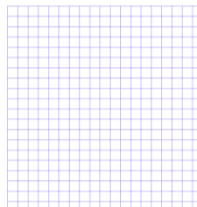
The value of graph paper

Slide 18
Creating a polygon
Polygon pgram = new Polygon();
pgram.addPoint (30, 130);
pgram.addPoint (50, 200);
pgram.addPoint (160, 200);
pgram.addPoint (140, 130);
g.setColor (Color.green);
g.fillPolygon (pgram);
g.setColor (Color.black);
g.drawPolygon(pgram);

Slide 19
